Slide 1
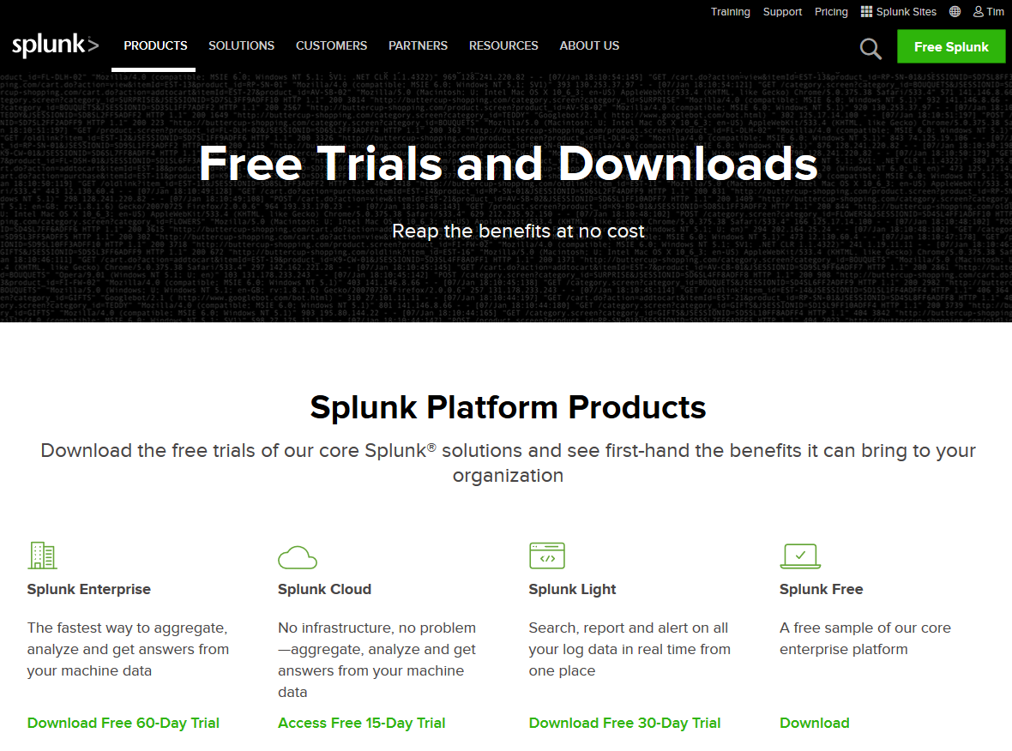
https://www.splunk.com/en_us/download.html

Slide 2
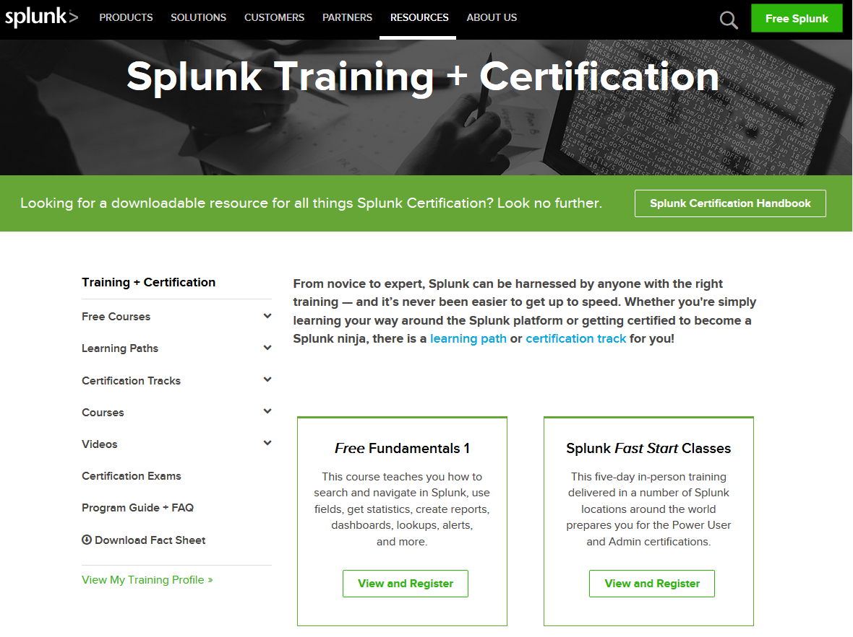
https://www.splunk.com/en_us/training.html

Slide 3
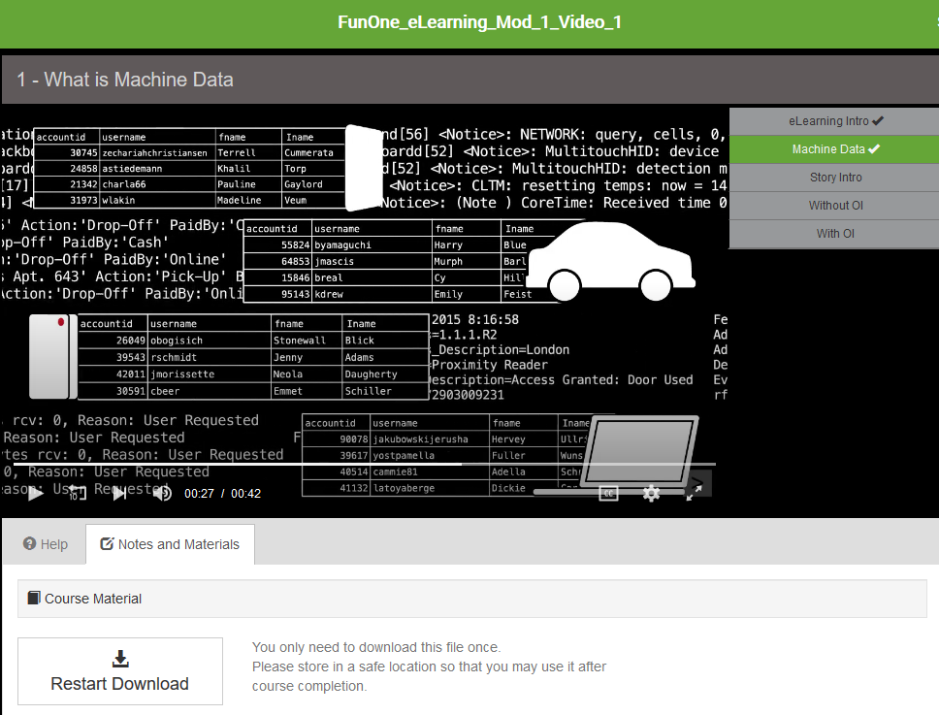
14 Training Modules

Slide 4
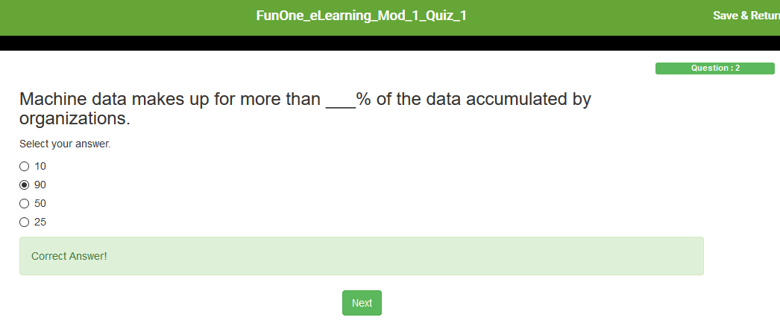
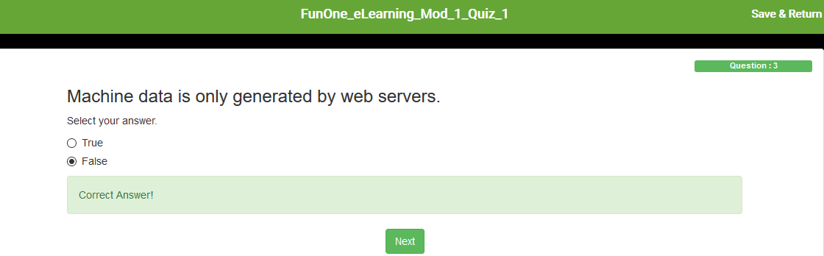
Quiz for Each Module, Certificate Upon Completion

Slide 5
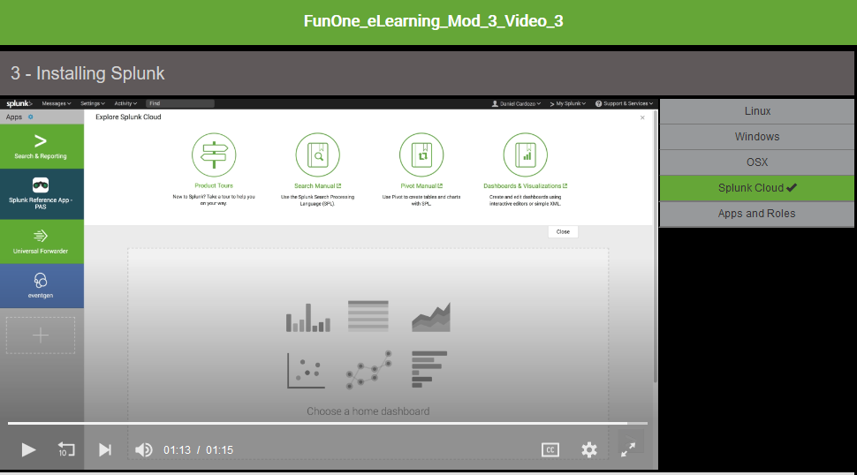
Splunk Cloud Dashboard

Slide 6
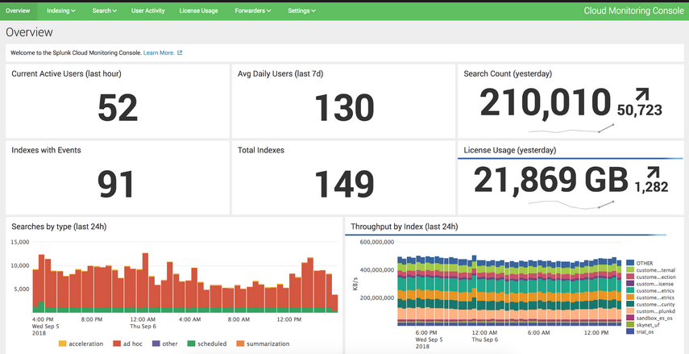
Production Dashboard View

